Slide 1
JOURNEY SCRAPBOOK
- Dhruv Bhatia

Slide 2



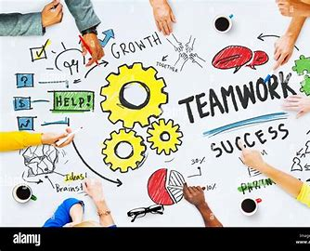
DAY 1 - 14 AUG 2023 – SOFT SKILLS
Shifting from Campus to Corporate
Teamwork
Networking

Slide 3
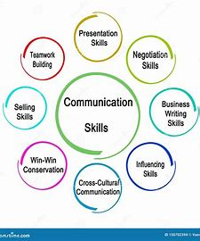
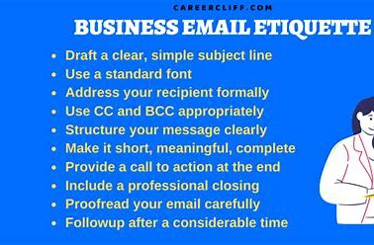
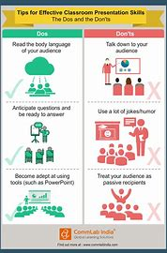
DAY 2 - 16 AUG 2023 – SOFT SKILLS
Presentation skills
Unravelling Communication
Team Meetings
Email etiquettes

Slide 4


DAY 3 - 17 AUG 2023 – SOFT SKILLS
Goal setting
Importance of Goals – direction in life, meaning of life, determine priorities, get organized, make decisions, to get to your destination.
Office Etiquette –
Understand your work environment.
Be mindful of how others work.
Be polite and professional in all communication forms.

Slide 5

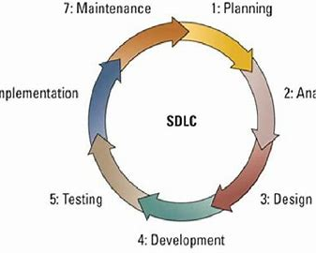
DAY 4 - 18 AUG 2023 – INTRODUCTION TO BUSINESS ANALYSIS AND AGILE
BUSINESS ANALYSIS - Business Analysis is the practice of enabling change in an organizational context, by defining needs and recommending solutions that deliver value to stakeholders.
Identifying business needs
Gathering requirements
Analyzing the requirements
Documenting the requirements
SDLC Model - A framework that describes
the activities performed at each stage of a
software development project.

Slide 6
DAY 4 - 18 AUG 2023 – INTRODUCTION TO BUSINESS ANALYSIS AND AGILE
Requirement Analysis - It is the process of defining user expectations for a new software being built or modified
Requirement Elicitation - It is the practice of researching and discovering the requirement of a system from users, customers, and other stakeholders.
Techniques – Brainstorming, Document Analysis, Focus Groups, Interviews, Prototyping, Workshops, Survey/ Questionnaire
Requirement Modelling - identifies the requirements that a software application or system must meet in order to solve the business problem.
Types of modelling – Scenario based, Class based, Data based
Requirement Management - iterative set of activities that help ensure that elicitation, documentation, refinement, and changes of requirements is adequately dealt with during a lifecycle.
Management Techniques - Work Breakdown Structure, Gantt Charts, Critical Path Method, WaterFall, Kanban, Scrum

Slide 7
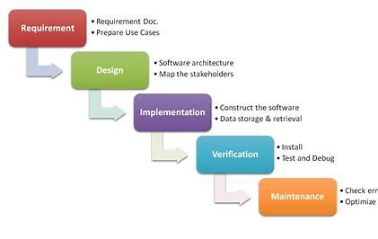
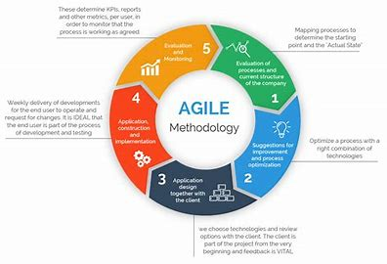
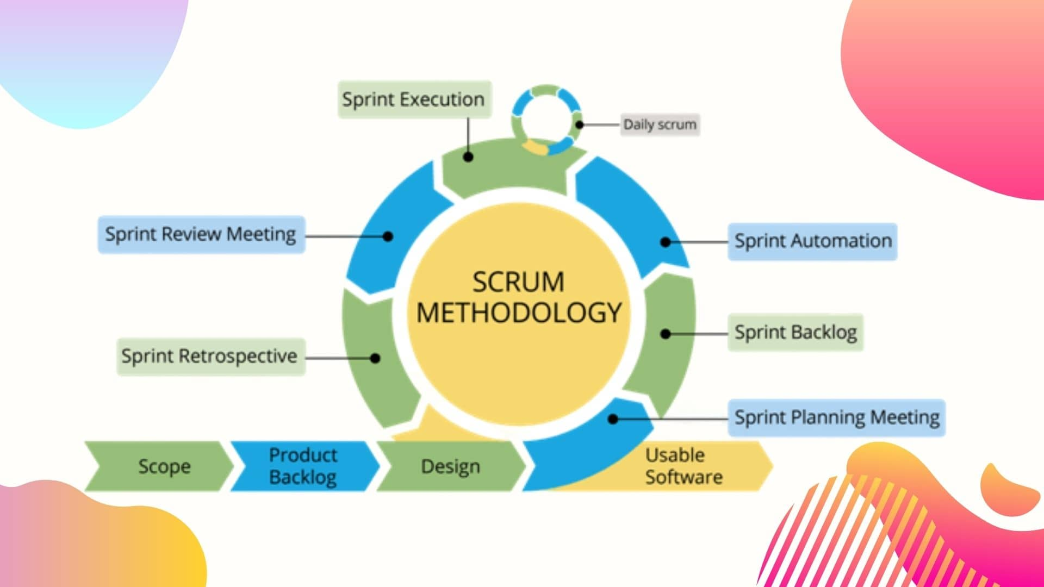
DAY 4 - 18 AUG 2023 – INTRODUCTION TO BUSINESS ANALYSIS AND AGILE
Waterfall model
Agile Methodology
Scrum Methodology

Slide 8
DAY 5 - 21 AUG 2023 – INTRODUCTION TO BUSINESS ANALYSIS AND AGILE
Setting up Azure DevOps
Epic - Is simply a story but is considered so large that it needs to be broken down into multiple stories. Large, long running objective composed of many Features and User Stories.
Story - Is essentially a requirement that is in a low enough detail that it can be estimated.
Task - Developers, testers may break the story down further into tasks to allow them to estimate, develop and test it.
Sub Task - Division of a parent issue (task) into chunks of work that can be assigned and tracked individually
Enabler - supports the activities needed to extend the Architectural Runway to provide future business functionality.
Spike - a timeboxed user story or Task that is created in order to research a question or resolve a problem.
Story points - units of measurement used to determine how much effort is required to complete a PBI or any other piece of work.

Slide 9
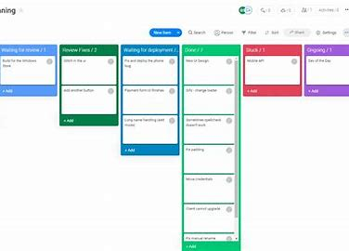
DAY 5 - 21 AUG 2023 – INTRODUCTION TO BUSINESS ANALYSIS AND AGILE
Definition of Ready(DoR) - a user story needs to meet some criteria (or conditions) before it can be picked up for a sprint.
Definition of Done(DoD) - specific type of working agreement. It captures the shared understanding of a team about what “done” means to them.
Agile Workflow - Scrum is an agile workflow process based on a repetitive approach. Scrum emphasizes continual improvement for customer satisfaction. The workflow of Scrum consists of 'Product Backlog', 'Planning Sprint', 'Sprint Backlog’, 'Sprint', 'Routine Scrum Meetings', 'Sprint Reviewal' and 'Internal Scrum Meetings'.
Scrum board - a visual representation of the work to be done in a single sprint.

Slide 10

DAY 5 - 21 AUG 2023 – INTRODUCTION TO BUSINESS ANALYSIS AND AGILE
Burn-down chart - represents data quickly in a chart format. The sprint burndown chart is a publicly displayed chart showing remaining work in the sprint backlog.
Burnup chart - a visual representation of a sprint's completed work compared with its total scope.
Velocity chart - overview of how much work has been delivered for each sprint.

Slide 11
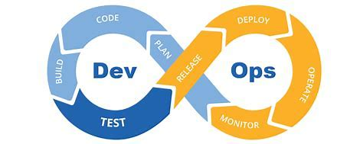
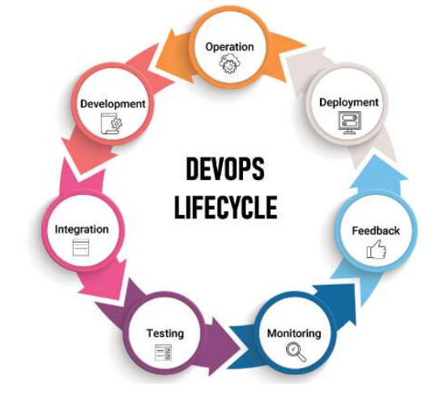
DAY 6 - 22 AUG 2023 – DEVOPS
DevOps - a combination of two words one is Development and other is Operations. It is just a culture to promote development and Operation process collaboratively.
DevOps Principles – Automation, Iteration, Continuous Improvement, Collaboration
Benefits - Faster time to market, Higher ROI, Greater user/customer satisfaction, Increased efficiency, Improved collaboration, Early detection and correction of issues

Slide 12
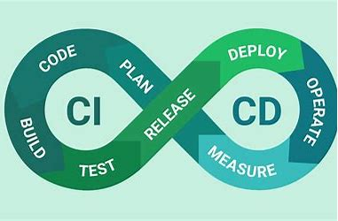
DAY 6 - 22 AUG 2023 – CICD
Continuous integration is a process in devops where changes are merged into a central repository after which the code is automated and tested.
Continuous Delivery is an extension of continuous integration since it automatically deploys all code changes to a testing and/or production environment after the build stage.
Continuous Deployment goes one step further than continuous delivery. Continuous deployment is an excellent way to accelerate the feedback loop

Slide 13
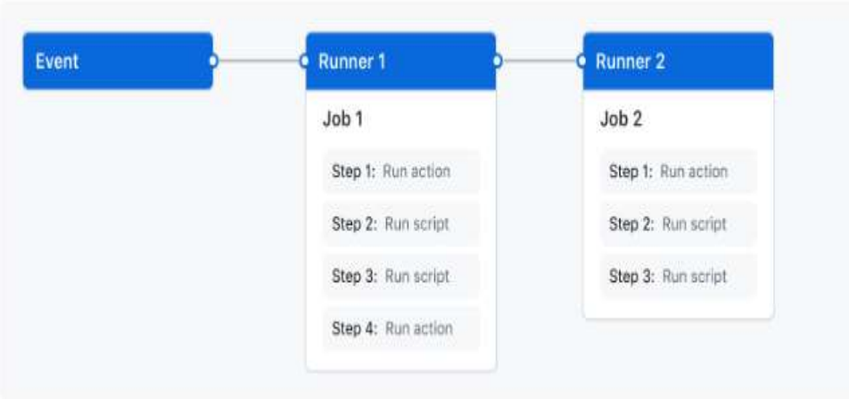
DAY 6 – 22 AUG 2023 – GITHUB ACTIONS
Workflows
Events
Jobs
Actions
Runners
GitHub Actions uses YAML syntax to define the workflow. Each workflow is stored as a separate YAML file in your code repository, in a directory named .github/workflow

Slide 14
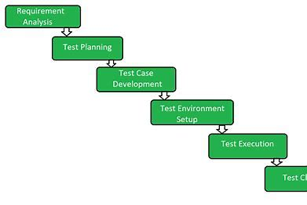
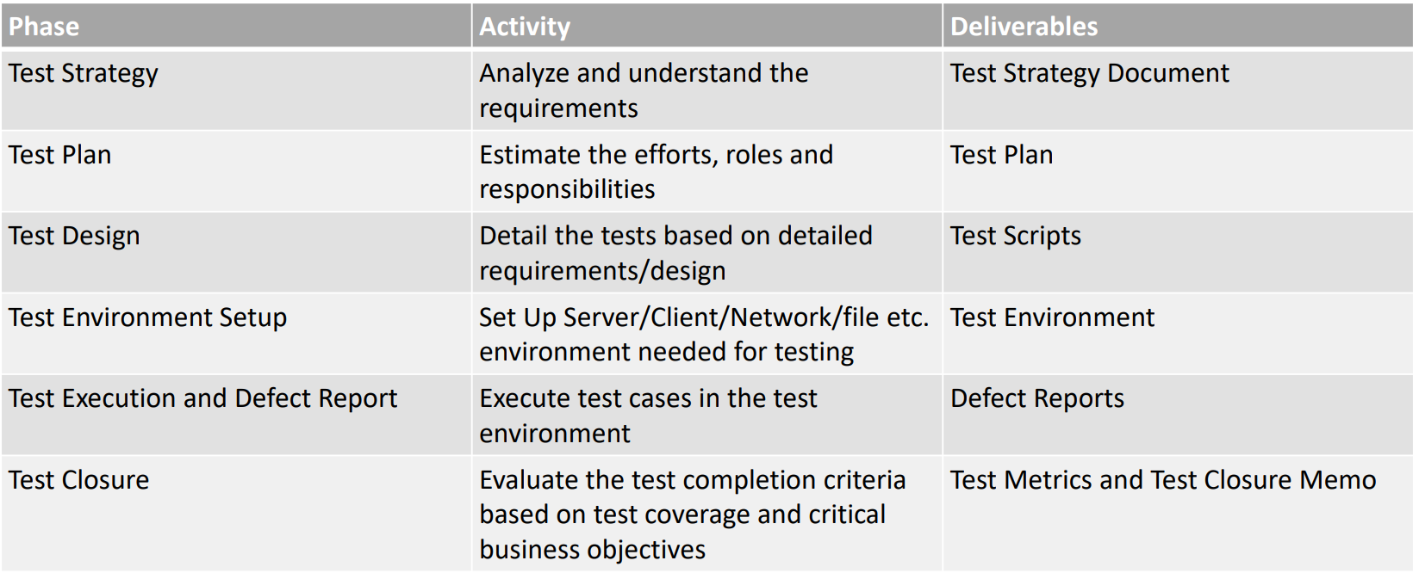
DAY 7 - 23 AUG 2023 – SOFTWARE TESTING
Software Testing is an activity that helps in identifying bugs/defects/errors in a software system under development, in order to provide a defect-free and reliable system/solution to the customer.
STLC defines the stages/phases in testing of software.

Slide 15
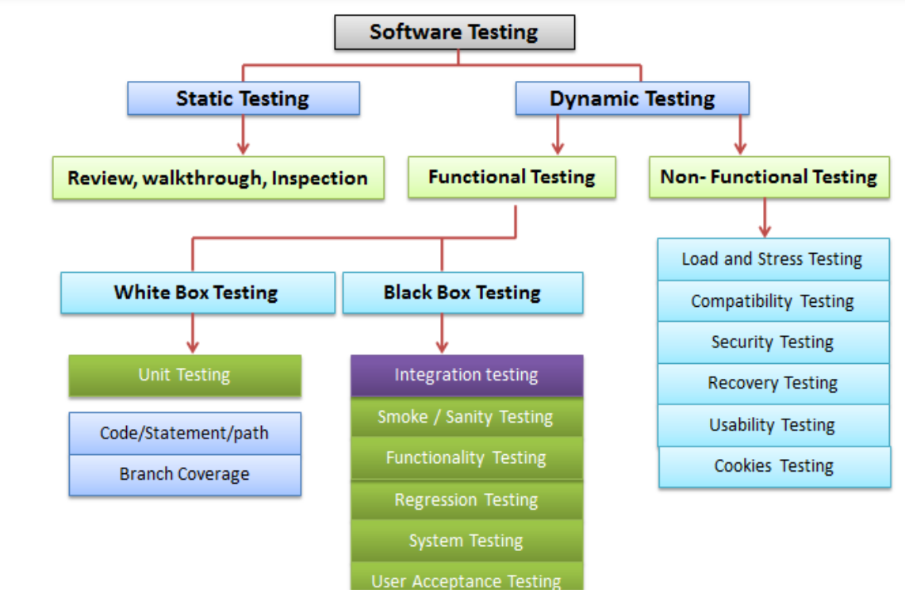
DAY 7 - 23 AUG 2023 – SOFTWARE TESTING

Slide 16
DAY 7 – 23 AUG 2023 – SOFTWARE TESTING
Manual Testing is the process of executing developed testcases on the application by a test engineer.
Automation Testing is the process of executing test scripts on an application with the help of a tool.
A unit test is a way of testing a unit - the smallest piece of code that can be logically isolated in a system.
TDD - a software development practice that focuses on creating unit test cases before developing the actual code
ATDD - focuses on capturing the accurate requirements
BDD - a testing approach derived from the Test-Driven Development (TDD) methodology
DDD - To tackle a complex domain. This complexity is not due to the technical elements of the project such as networking, databases or platform, but rather the domain itself.

Slide 17
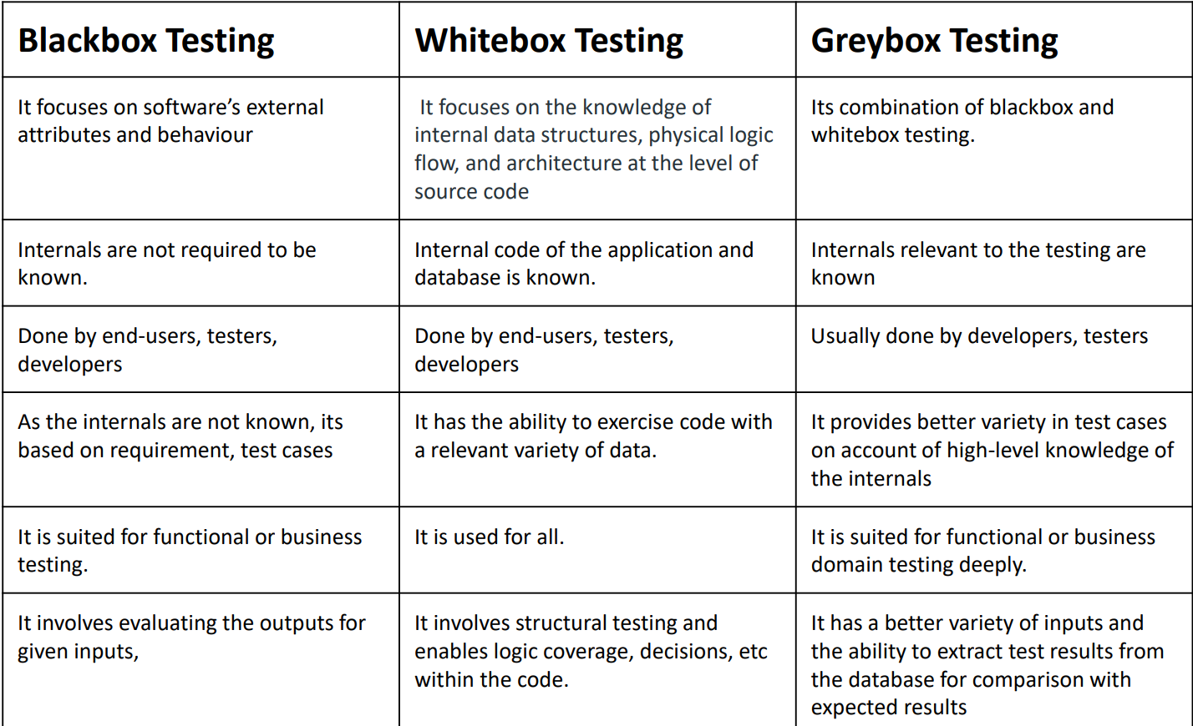
DAY 7 - 23 AUG 2023 – SOFTWARE TESTING

Slide 18
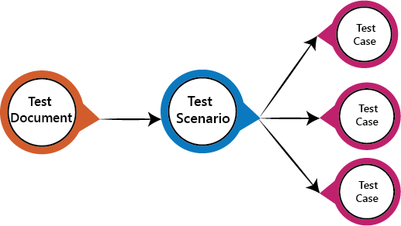
DAY 7 - 23 AUG 2023 – SOFTWARE TESTING
A Test Scenario summarizes the functionality to be tested without providing the steps to be followed to test the functionality mentioned in the Use Case/Functional Specification.
A Test Case is defined as a set of test inputs, execution conditions, and expected results developed for a particular objective, such as to exercise a particular program path or to verify compliance with a specific requirement.
Test data is an integral part of the testing process for a tester. It provides information to the tester to facilitate finding defects and corrective actions.

Slide 19
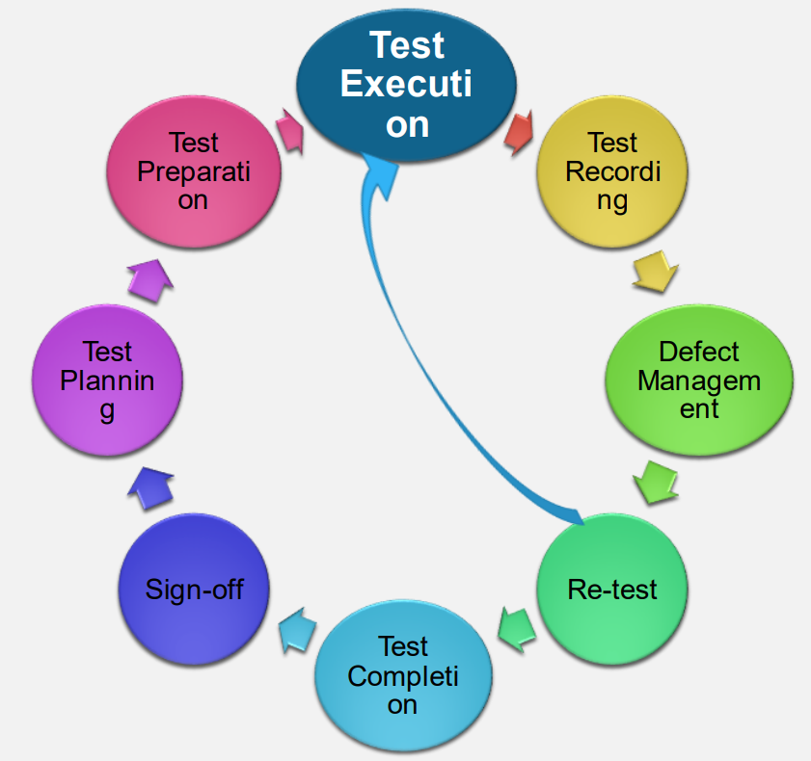
DAY 8 - 24 AUG 2023 – PROFESSIONAL SOFTWARE TESTING
Test Execution is the process of executing all or a selected number of test cases and observing the results.
A software defect is an error (bug), flaw, mistake, failure, or fault in a computer program that prevents it from behaving as intended.
The duration between the detection of a defect and closing the defect successfully is called as the software defect life cycle.

Slide 20
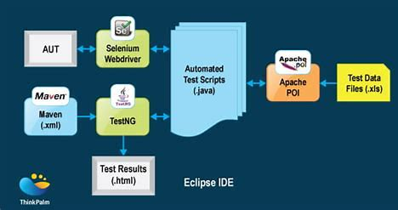
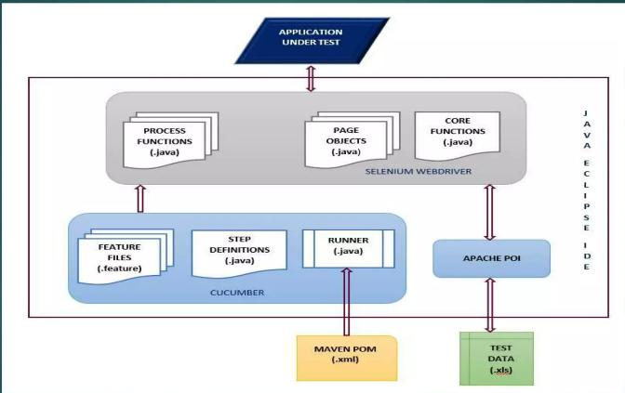
DAY 8 - 24 AUG 2023 – SELENIUM,CUCUMBER TEST AUTOMATION FRAMEWORK

Slide 21
DAY 8 - 24 AUG 2023 – PROFESSIONAL SOFTWARE TESTING
Locators provide a mechanism to access the HTML elements on a web page.
ID, Name, LinkText, Partial Link Text, Tag Name, CSS Class, CSS Selector, XPATH
ID - It is a unique reference for a web object that the developer sets while writing the code.
WEB DRIVER DEMO:
System.setProperty(driver,”path of the driver executable”);
Webdriver driver = new ChromeDriver();
driver.get(url);
WebElement elementname = driver.findElement(By.identifier(properties));
object.sendKeys(“value”);
object.selectVisibleText(value);
Int size = object.getOptions().size();
Boolean output = object.get(index).isSelected();
getAttribute(property).method();

Slide 22
DAY 8 - 24 AUG 2023 – PROFESSIONAL SOFTWARE TESTING
Behavior-driven development (BDD) is an Agile software development methodology in which an application is documented and designed around the behavior a user expects to experience when interacting with it.
Test Driven Development is the process in which test cases are written before the code that validates those cases.
Apache Maven is a build automation tool for Java and other languages, using conventions and plugins. Learn about its history, features, syntax, and usage on Wikipedia.

Slide 23
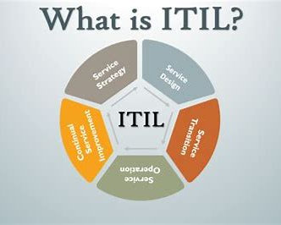
DAY 9 - 25 AUG 2023 – ITIL
ITIL is a framework to maintain IT Service Management which includes Planning, Design, Code, Test, Implementation, Raising ticket, Problem management, Change Management.

Slide 24
DAY 9 – 25 AUG 2023 – SECURITY
Phishing - a form of social engineering and scam where attackers deceive people into revealing sensitive information or installing malware such as ransomware.
Malware - any kind of computer software with malicious intent that can harm your system, data, or privacy.
A botnet is a group of Internet-connected devices, each of which runs one or more bots. Botnets can be used to perform Distributed Denial-of-Service (DDoS) attacks, steal data, send spam, and allow the attacker to access the device and its connection.
Hacking - unauthorized access to computers in order to steal, alter, or delete data, generally by installing malicious software without your knowledge or agreement.

Slide 25
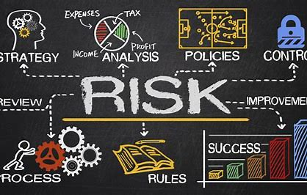
DAY 9 - 25 AUG 2023 – RISK MANAGEMENT
Risk management is the process of identifying, assessing and controlling financial, legal, strategic and security risks to an organization’s capital and earnings. These threats, or risks, could stem from a wide variety of sources, including financial uncertainty, legal liabilities, strategic management errors, accidents and natural disasters.
Quantitative risk analysis is a numeric evaluation of the general effect of risk on the project intents such as budget and agenda objectives.
Qualitative risk analysis is the process of identifying, analyzing and evaluating risks in an organization.

Slide 26
WEEK 3

Slide 27

DAY 1
Worked on the case study:
Issued some user story, epics, tasks and bugs
Forked the GitHub repository
Worked on VM
Installed and ran maven on VM
Used Docker
Used GitHub actions

Slide 28
DAY 2
Data warehousing
01
Difference between OLAP and OLTP
02
Difference between Data warehouse and Data mart
03
Data warehouse properties
04
Data cube: slicing, dicing
05

Slide 29
DAY 3
No-SQL, unstructured database
Difference between Structured and Unstructured database
Intro to Hadoop
Data lakes

Slide 30
DAY 4
Microsoft Azure SQL
Azure SQL editor
SQL queries
Group by
Joins

Slide 31
DAY 5
Intro to Microsoft azure database and Query editor
Hands on approach to:
Joins
Aggregate functions
Group by clause
Having clause
Sub-queries

